Slide 1
MongoDB for Cloud Native application
Ottawa
Cloud Native - Meetup November 15th, 2018

Slide 2

Sani
Chabi Yo
Sr. Solution Architect, MongoDB
schabiyo

Slide 3

Agenda
1. Introduction to MongoDB
2. Kubernetes Operator for MongoDB
2. MongoDB Atlas
3. MongoDB Stitch
60 minutes
Notes:
Common trends with our enterprise customers
moving toward PaaS solutions
tasked with building "cloud-enabled" applications
using various "orchestration" platforms
evolving legacy application to microservices
going 'serverless'
Kubernetes (cube - er - netties) - Open source platform for managing containerized workloads and services.

Slide 4
Introduction to MongoDB

Slide 5
MongoDB’s Intelligent Operational Data Platform is the best way of making your data simple
to Organize, Use, & Enrich
in Real Time, Anywhere

Slide 6

Why MongoDB?
Intelligent Operational Data Platform
Best way to work with data
Intelligently put data where you need it
Freedom to run anywhere

Slide 7
Some Terminology
A comparison
RDBMS
Database
Table
Parent – Child Tables
Index
Row
Column
Join
View
Multi-Record ACID Transaction
Database
Collection
Nested Sub-Document or Array
Index
Document**
Field
Embedding, Linking, $lookup
View
Multi-Document ACID Transaction*
MongoDB
* Scheduled for MongoDB 4.0
** Proper document schema design yields more entity data per document than found in a relational database row

Slide 8
Best way to work with data
Easy:
Work with data in a natural, intuitive way
Flexible:
Adapt and
make changes quickly
Fast:
Get great performance with less code
Versatile:
Supports a
wide variety of data models
and queries
Notes:
Developer productivity, driving business productivity

Slide 9
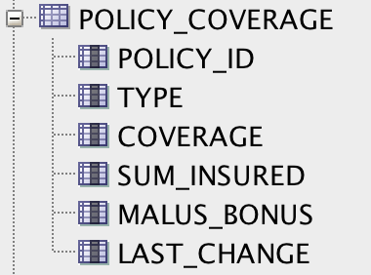
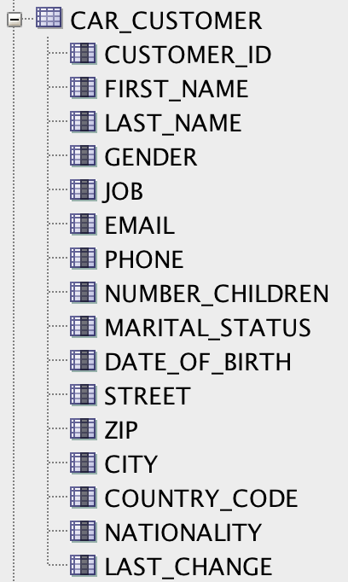
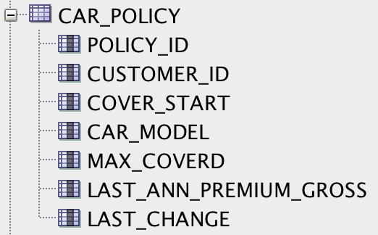
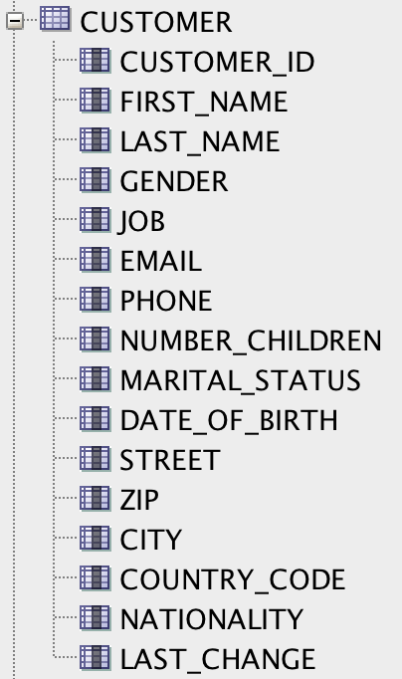
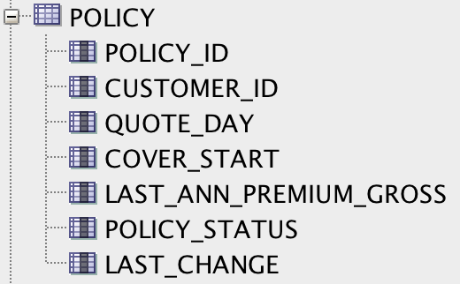
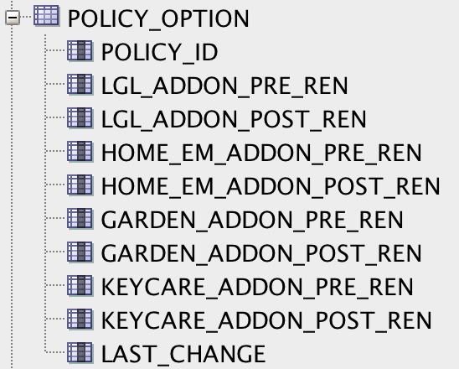
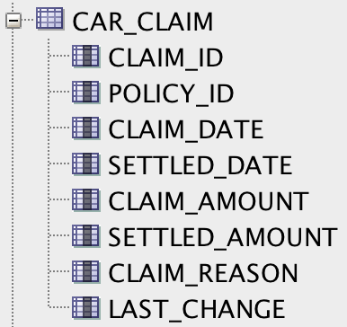
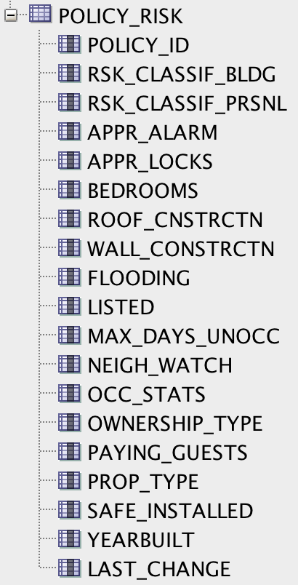
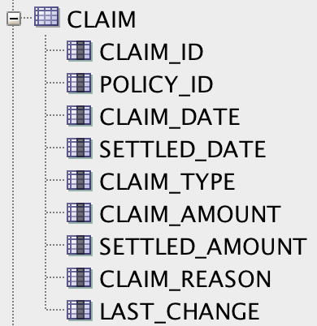
Tabular/Relational Data model
Car Insurance
Home Insurance

Slide 10
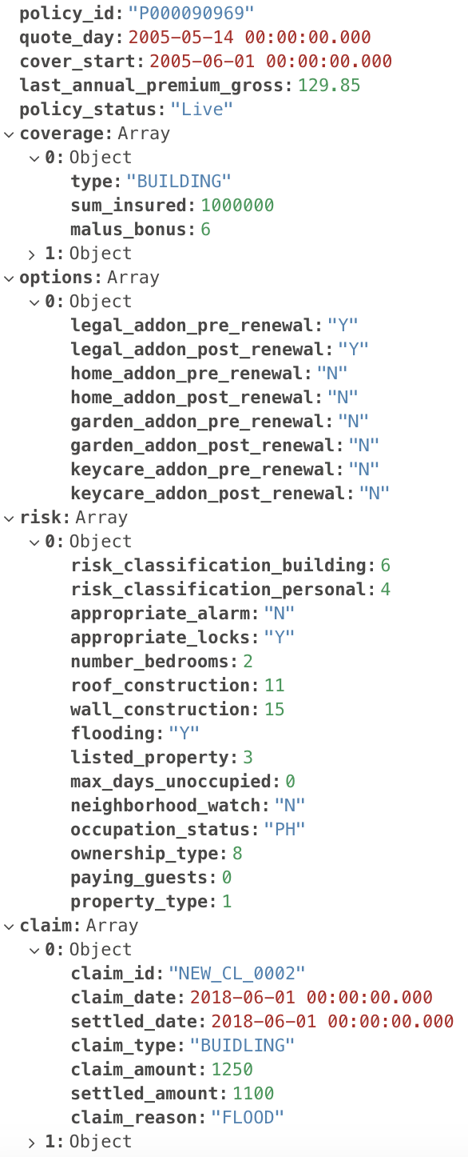
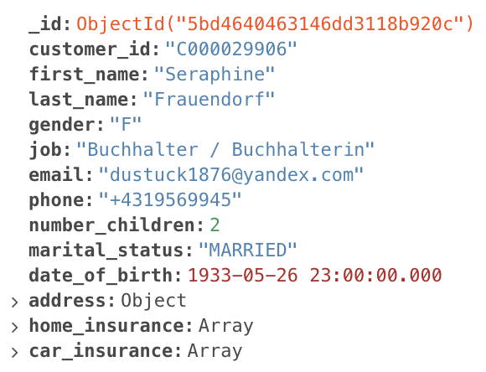
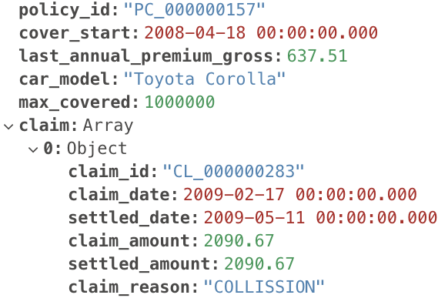
Data model mongodb

Slide 11

Intelligently put data where you need it
Highly Available
Built-in multi-region high availability, replication & automated failover
Workload Isolation
Ability to run both operational & analytics workloads on same cluster, for timely insight and lower cost
Scalability
Elastic horizontal scalability – add/remove capacity dynamically without downtime
Locality
Declare data locality rules for governance (e.g. data sovereignty), class of service & local low latency access

Slide 12
MongoDB Replica Sets
Replica Set – 2 to 50 copies
Self-healing
Data Center Aware
Addresses availability considerations:
High Availability
Disaster Recovery
Maintenance
Workload Isolation: operational & analytics
Application
Driver
Primary
Replication
Secondary
Secondary
Notes:
High Availability – Ensure application availability during many types of failures
Disaster Recovery – Address the RTO and RPO goals for business continuity
Maintenance – Perform upgrades and other maintenance operations with no application downtime
Secondaries can be used for a variety of applications – failover, hot backup, rolling upgrades, data locality and privacy and workload isolation

Slide 13
Sharding Architecture
Application
Driver
•••
Mongos
Mongos
•••
Shard 1
Shard 2
Shard N
High availability
Replica sets
Primary
Primary
Primary
Secondary
Secondary
•••
Secondary
Secondary
Secondary
Secondary
Horizontal scalability
Sharding

Slide 14

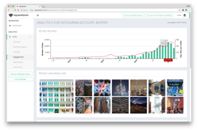

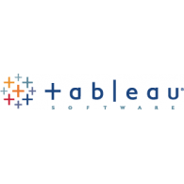


Co-locating operational and analytical workloads
Operational (interactive)
Analytics
BI & Reporting
PRIMARY
Secondary
Secondary
Secondary
{use = analytics}
Predictive Analytics
Aggregations
Notes:
The same level of isolation can be achieved with different application workloads.
E.g. Analytics don’t need user interaction - they can run slowly overnight.
MongoDB leverages Replica Sets - copies of the database distributed across racks, datacenters or regions. Applications can be directed to these copies to execute their workloads. The act of creating an entire copy and dedicating that copy to isolated workloads enables flexibility, reduces complexity and adds value to the data.

Slide 15

Freedom to run anywhere
Local
On-premises
Server & Mainframe
Private cloud
Hybrid cloud
Public cloud
Fully managed
cloud service
Database that runs the same everywhere
Leverage the benefits of a multi-cloud strategy
Global coverage
Avoid lock-in
Convenience: same codebase, same APIs, same tools, wherever you run

Slide 16
Kubernetes Operator for MongoDB

Slide 17
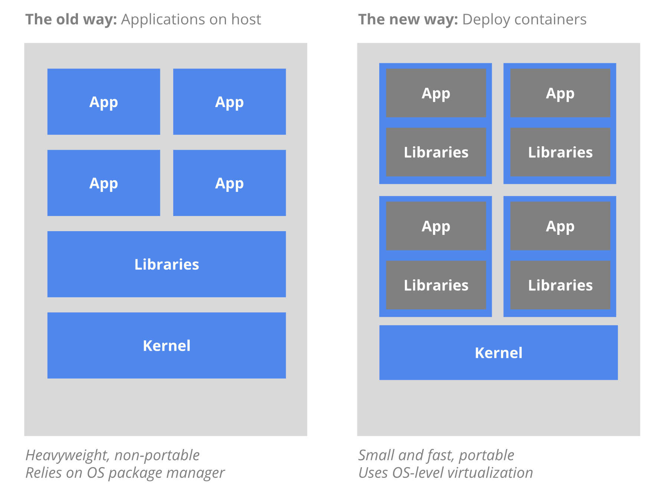
Technologies - Containers
A standardized unit of software
lightweight, standalone, executable package of software that includes everything needed to run an application: code, runtime, system tools, system libraries and settings
(https://www.docker.com/resources/what-container)

Slide 18
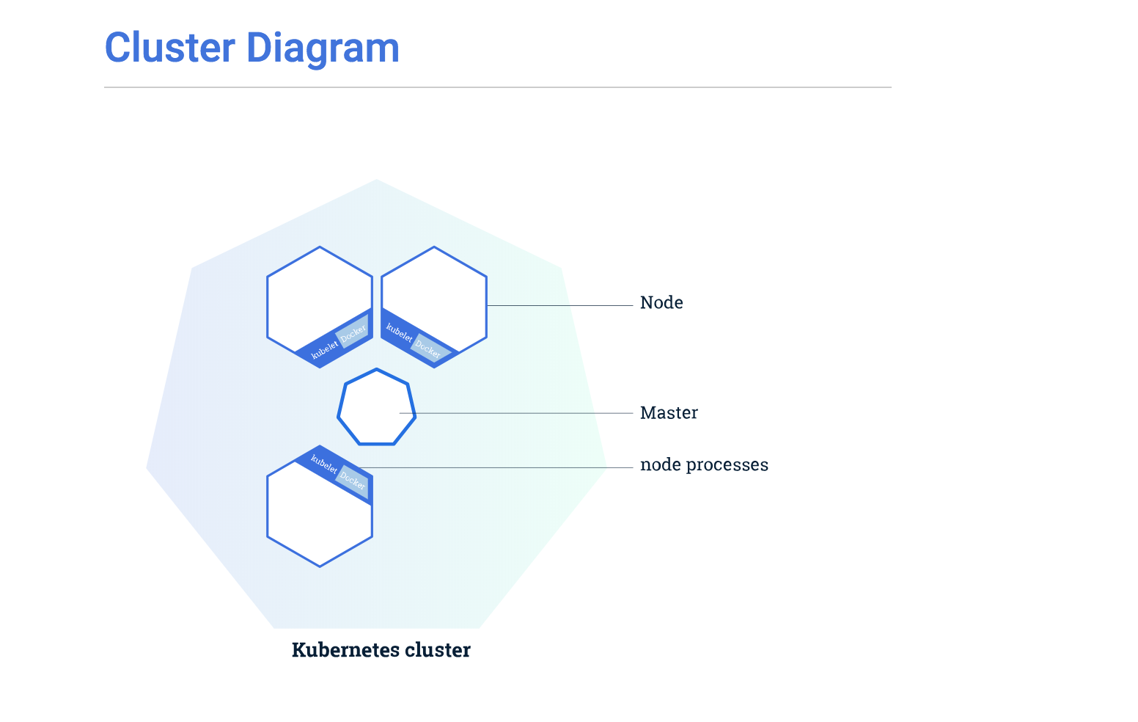
Technologies - Kubernetes
Kubernetes is an open-source system for automating deployment, scaling, and management of containerized applications.
(https://kubernetes.io/)
Important Concepts: Master Node, Worker Nodes, Pods, Image Repo, API
Requirement: >= v1.9

Slide 19
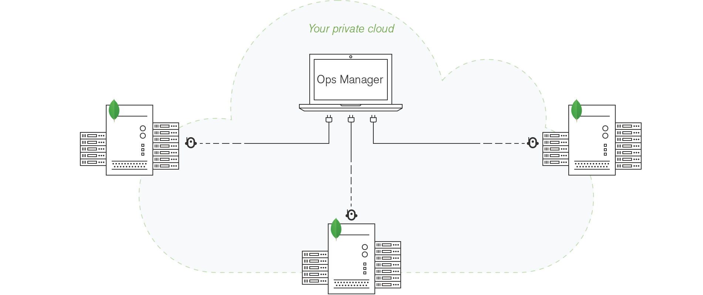
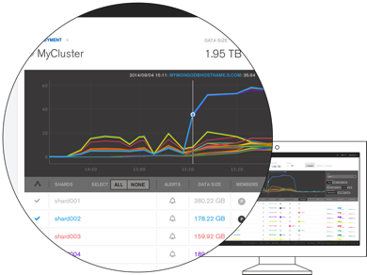
Technologies - MongoDB Ops Manager
Ops Manager is a package for managing MongoDB deployments.
Management (Automation)
Monitoring
Backups
Cloud Manager
Notes:
AND…. of course MongoDB!

Slide 20
Technologies - Kubernetes Operators
Kubernetes
An Operator is a method of packaging, deploying and managing a Kubernetes application. A Kubernetes application is an application that is both deployed on Kubernetes and managed using the Kubernetes APIs and kubectl tooling..
https://www.docker.com/resources/what-container
Operator
MongoDB Ops Manager
Notes:
AND…. of course MongoDB!

Slide 21
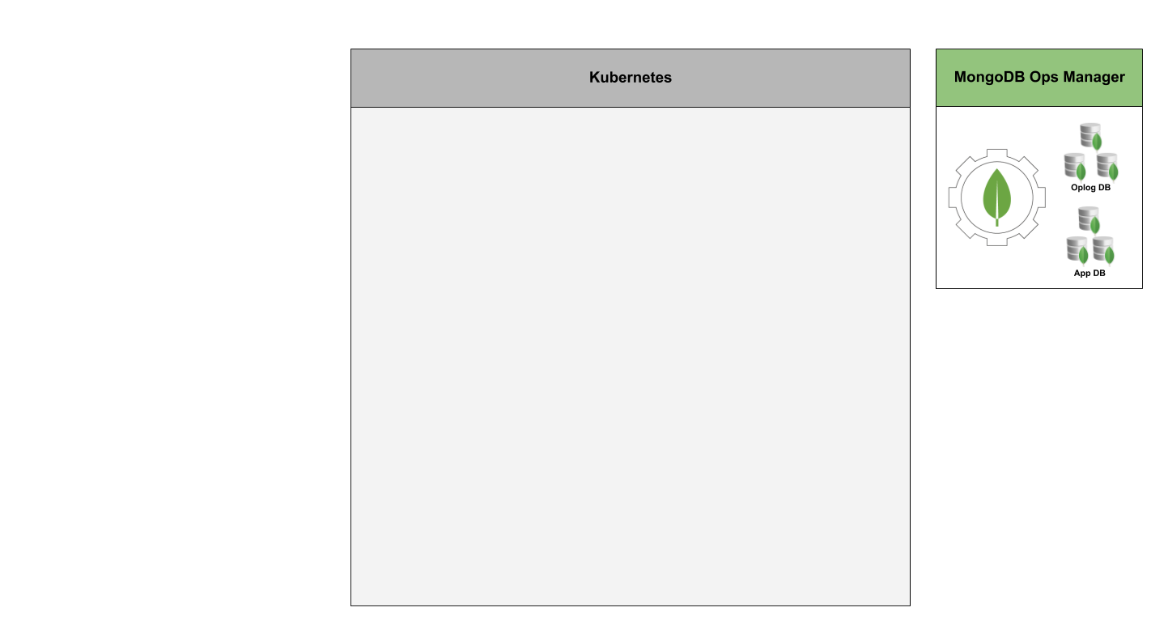
Architecture (1)

Slide 22
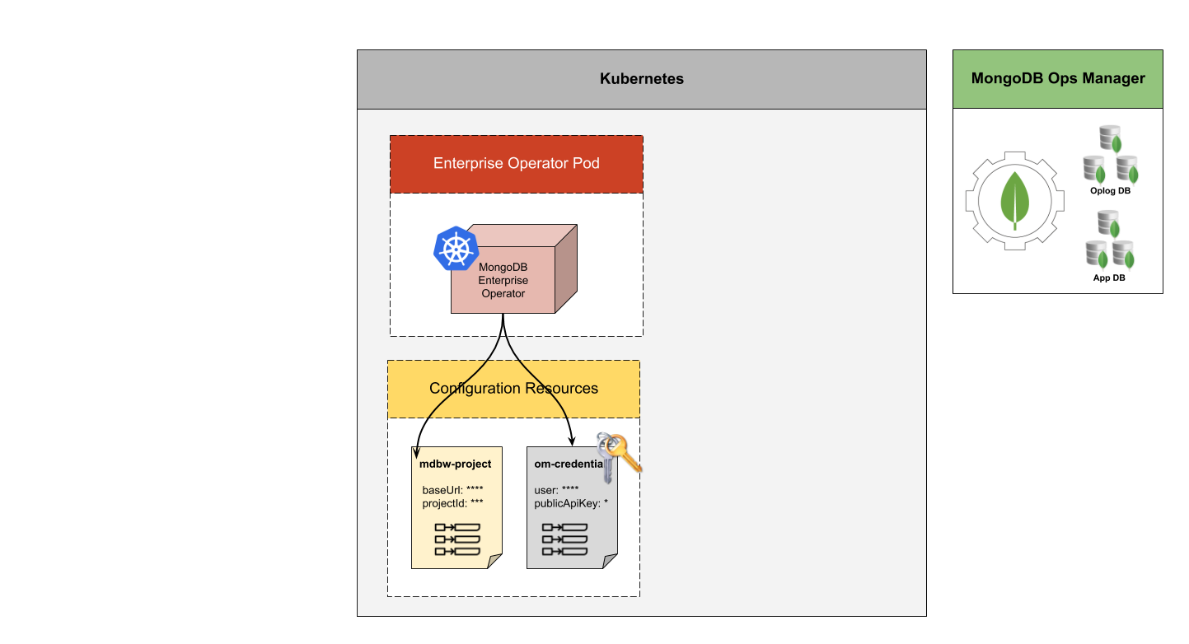
Architecture (2)

Slide 23
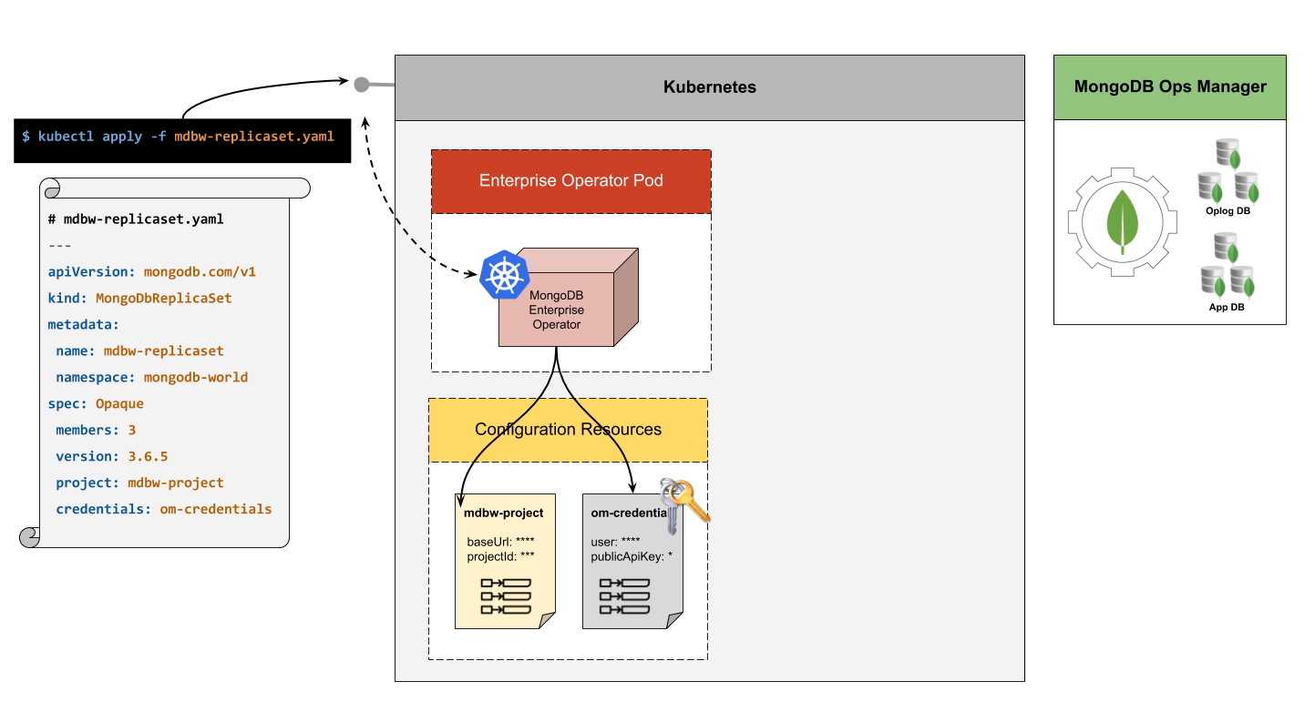
Architecture (3)

Slide 24
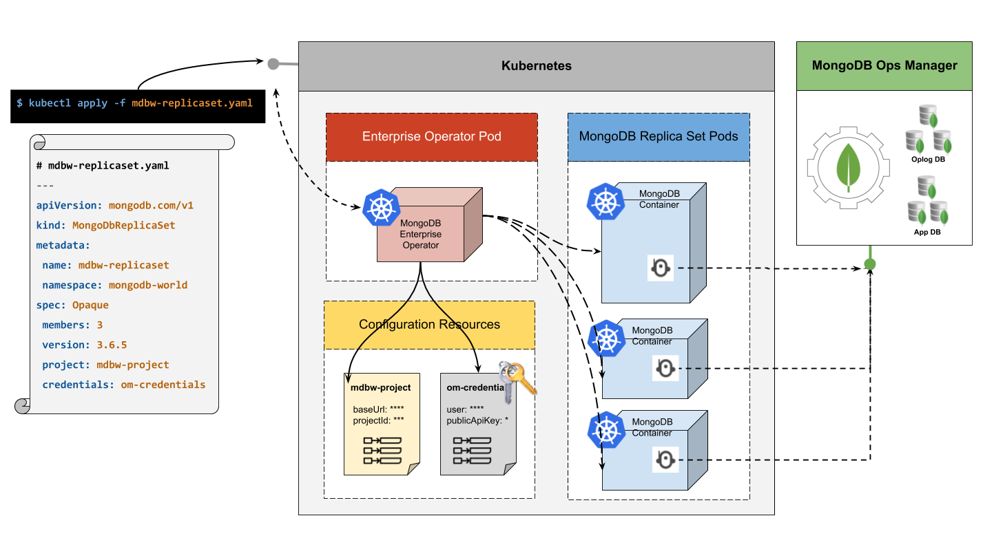
Architecture (4)

Slide 25
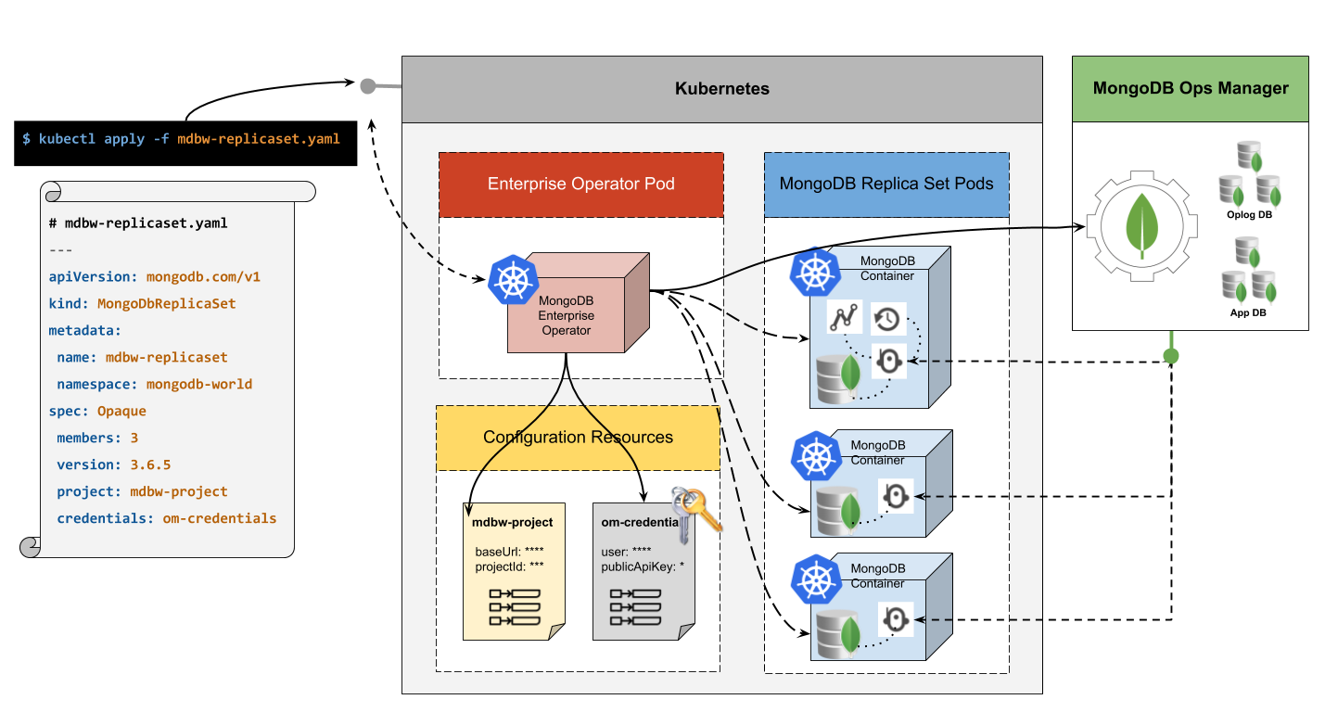
Architecture (5)

Slide 26
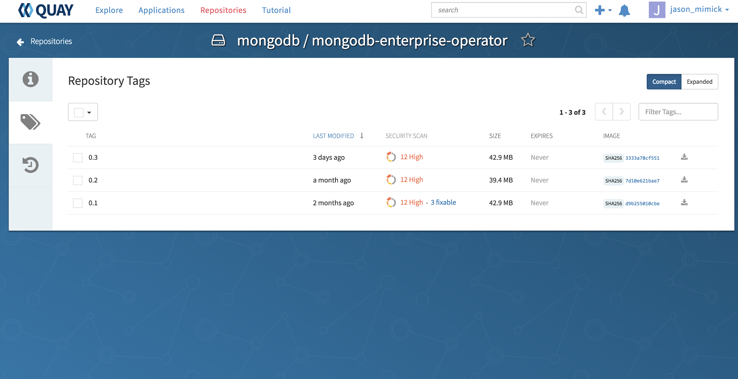
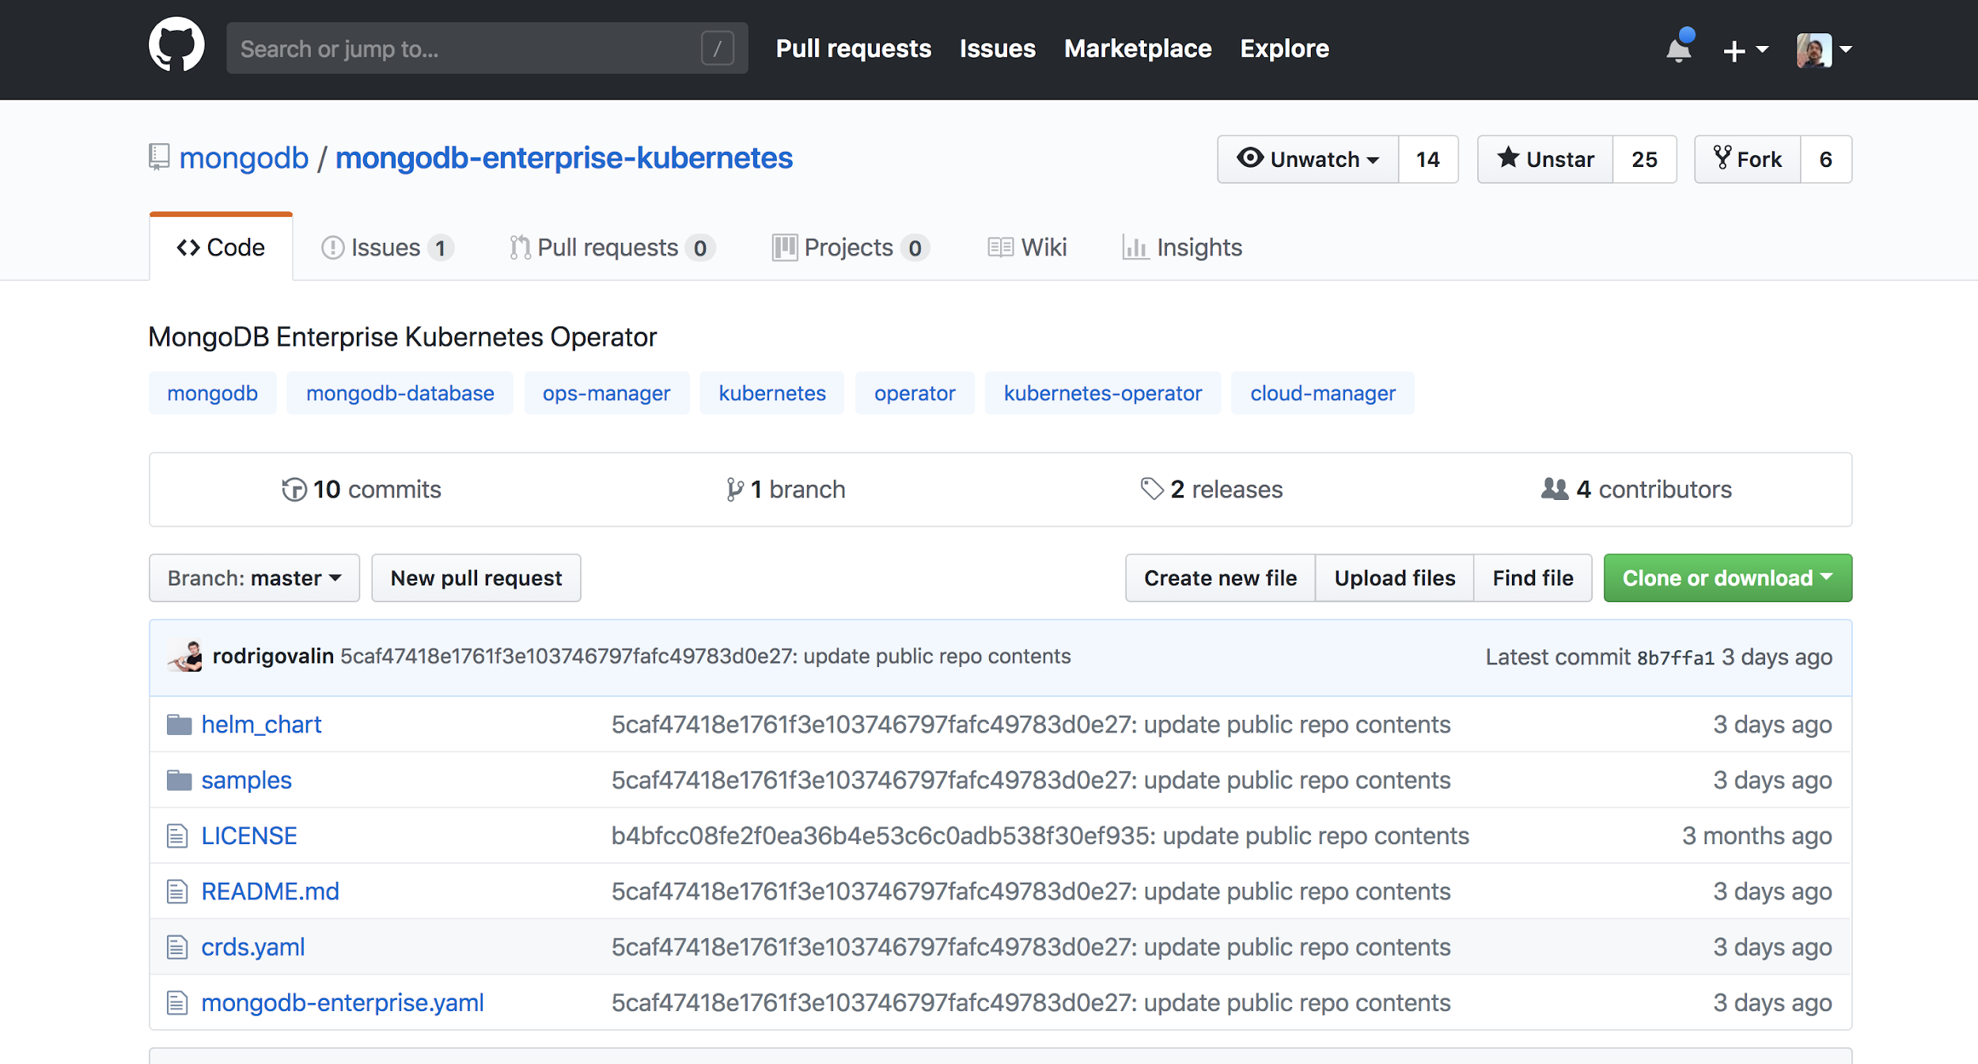
Getting the operator
Official container images hosted on quay.io
Public GitHub repository
https://github.com/mongodb/mongodb-enterprise-kubernetes
Notes:
Yaml files to install Operator
Helm Chart
Sample deployment yaml's

Slide 27
Getting started with the Operator

Slide 28
Spin up k8s & install operator
https://docs.opsmanager.mongodb.com/current/tutorial/install-k8s-operator/
# Start cluster
minikube start
# Install operator
kubectl create -f ./mongodb-enterprise.yaml
# set default namespace (op creates & installs to 'mongodb')
kubectl config set-context $(kubectl config current-context)\ --namespace=mongodb
# See all operator stuff
kubectl get all --selector=app=mongodb-enterprise-operator

Slide 29
Configuration - Connection to Ops Manager
---
apiVersion: v1
kind: ConfigMap
metadata:
name: ottawa
data:
projectId: 5b76d1750bd66b7ea136427f
baseUrl: https://cloud.mongodb.com/
---
apiVersion: v1
kind: Secret
metadata:
name: opsmgr-credentials
stringData:
user: sani.chabi-yo
publicApiKey: 02b9674b-e912-4bf5-bec3-43687832a6cd

Slide 30
Create Secret & ConfigMap
kubectl create -f opsmgr-credentials.yaml
kubectl create -f ottawa-project.yaml
kubectl get configmaps,secrets

Slide 31
Deploying a Replica Set
apiVersion: mongodb.com/v1
kind: MongoDbReplicaSet
metadata:
name: ottawa-rs1
namespace: mongodb
spec:
members: 3
version: 4.0.0
project: ottawa
credentials: opsmgr-credentials
podSpec:
storageClass: standard

Slide 32
kubectl create -f ottawa-rs1.yaml
kubectl get all --selector=app=ottawa-rs1-svc NAME READY STATUS RESTARTS AGE pod/ottawa-rs1-0 1/1 Running 12 13h pod/ottawa-rs1-1 1/1 Running 12 13h pod/ottawa-rs1-2 1/1 Running 12 13h NAME TYPE CLUSTER-IP EXTERNAL-IP PORT(S) AGE service/ottawa-rs1-svc ClusterIP None <none> 27017/TCP 13h service/ottawa-rs1-svc-external NodePort 10.102.95.40 <none> 27017:30780/TCP 13h NAME DESIRED CURRENT AGE statefulset.apps/ottawa-rs1 3 3 13h
Notes:
Note what k8s object are created. Service, StatefulSet, Pods = note external service not "right" yet!

Slide 33
High Availability - replication + statefulset =
kubectl delete pod ottawa-rs1-1 pod ”ottawa-rs1-1" deleted root@ip-172-31-19-43:~# kubectl get all --selector=app=ottawa-rs1-svc NAME READY STATUS RESTARTS AGE pod/ottawa-rs1-0 1/1 Running 12 13h pod/ottawa-rs1-1 1/1 Running 0 1m pod/ottawa-rs1-2 1/1 Running 12 13h NAME TYPE CLUSTER-IP EXTERNAL-IP PORT(S) AGE service/ottawa-rs1-svc ClusterIP None <none> 27017/TCP 13h service/ottawa-rs1-svc-external NodePort 10.102.95.40 <none> 27017:30780/TCP 13h NAME DESIRED CURRENT AGE statefulset.apps/ottawa-rs1 3 3 13h
Notes:
MongoDB replication ensures your apps can always connect to their data service.
Running MongoDB on Kubernetes ensures your replica set nodes automatically recover themselves.
StatefulSets guarantees same storage attached.

Slide 34
Scaling
# vim ottawa-rs1.yaml # kubectl apply -f ottawa-rs1.yaml mongodbreplicaset.mongodb.com/ottawa-rs1 configured # kubectl get all --selector=app=ottawa-rs1-svc NAME READY STATUS RESTARTS AGE pod/ottawa-rs1-0 1/1 Running 12 13h pod/ottawa-rs1-1 1/1 Running 0 3m pod/ottawa-rs1-2 1/1 Running 12 13h pod/Ottawa-rs1-3 1/1 Running 0 10s NAME TYPE CLUSTER-IP EXTERNAL-IP PORT(S) AGE service/ottawa-rs1-svc ClusterIP None <none> 27017/TCP 13h service/ottawa-rs1-svc-external NodePort 10.102.95.40 <none> 27017:30780/TCP 13h NAME DESIRED CURRENT AGE statefulset.apps/ottawa-rs1 4 4 13h

Slide 35
Resource requests
memory, cpu, storage, affinity

Slide 36
Persistent Storage - DB right?
apiVersion: mongodb.com/v1 kind: MongoDbReplicaSet metadata: name: ottawa-rs1 namespace: mongodb spec: members: 3 version: 4.0.0 project: ottawa credentials: opsmgr-credentials podSpec: storage: 5G storageClass: managed-premium
Notes:
CPU, Memory, Storage/Storage Class/Node Affinity

Slide 37
Community Resources
Where to get involved and learn more
Github: https://github.com/mongodb/mongodb-enterprise-kubernetes
Slack: https://launchpass.com/mongo-db #enterprise-kubernetes
Talk to me!

Slide 38
MongoDB Atlas

Slide 39
Atlas unlocks agility and reduces cost
Self-service and elastic
Global and highly available
Secure by default
Comprehensive monitoring
Managed backup
Cloud agnostic
Notes:
Self-service and elastic:
Deploy in minutes
Scale up/down without downtime
Automated upgrades
Global and highly available:
50 Regions worldwide
Replica sets optimized for availability
Cross-region replication
Secure by default:
Network isolation and Peering
Encryption in flight and at rest
Role-based access control
SOC 2 Type 1 / Privacy Shield
Comprehensive monitoring:
Performance Advisor
Dashboards w/ 100+ metrics
Real Time Performance
Customizable alerting
Managed backup:
Point in Time Restore
Queryable backups
Consistent snapshots
Cloud agnostic:
AWS, Azure, and GCP
Easy migrations
Consistent experience

Slide 40
MongoDB Atlas — Global Cloud Database
Self-service & elastic
Deploy, modify, and upgrade on demand with best-in-class operational automation
Automated database maintenance
Database and infrastructure resources as code
Scale up, out, or down in a few clicks or API calls
Global & cloud-agnostic
Available in 56 regions across AWS, Azure, GCP
Global clusters for read/write anywhere deployments and multi-region fault tolerance
Easy migrations with a consistent experience across cloud providers
Enterprise-grade security & SLAs
Network isolation, VPC peering, end-to-end encryption, and role-based access controls
Encryption key management, LDAP integration, granular database auditing
SOC 2 / Privacy Shield / HIPAA
Guaranteed reliability with SLAs
Comprehensive monitoring
Deep visibility into 100+ KPIs with proactive alerting
Real-time performance tracking and Performance Advisor
APIs to integrate with monitoring dashboards
Managed backup
Point-in-time data recovery
Queryable backup snapshots
Consistent snapshots of sharded deployments
Cloud data mobility
Stitch: Serverless platform services
Simple, serverless functions for backend logic, service integrations, and APIs
Database access from your frontend secured by straightforward, field-level access rules
Database and authentication triggers to react to changes in real time

Slide 41
MongoDB Atlas — Global Cloud Database
Self-service & elastic
Deploy, modify, and upgrade on demand with best-in-class operational automation
Automated database maintenance
Database and infrastructure resources as code
Scale up, out, or down in a few clicks or API calls
Global & cloud-agnostic
Available in 56 regions across AWS, Azure, GCP
Global clusters for read/write anywhere deployments and multi-region fault tolerance
Easy migrations with a consistent experience across cloud providers
Enterprise-grade security & SLAs
Network isolation, VPC peering, end-to-end encryption, and role-based access controls
Encryption key management, LDAP integration, granular database auditing
SOC 2 / Privacy Shield / HIPAA
Guaranteed reliability with SLAs
Comprehensive monitoring
Deep visibility into 100+ KPIs with proactive alerting
Real-time performance tracking and Performance Advisor
APIs to integrate with monitoring dashboards
Managed backup
Point-in-time data recovery
Queryable backup snapshots
Consistent snapshots of sharded deployments
Cloud data mobility
Stitch: Serverless platform services
Simple, serverless functions for backend logic, service integrations, and APIs
Database access from your frontend secured by straightforward, field-level access rules
Database and authentication triggers to react to changes in real time

Slide 42
MongoDB Atlas — Global Cloud Database
Self-service & elastic
Deploy, modify, and upgrade on demand with best-in-class operational automation
Automated database maintenance
Database and infrastructure resources as code
Scale up, out, or down in a few clicks or API calls
Global & cloud-agnostic
Available in 56 regions across AWS, Azure, GCP
Global clusters for read/write anywhere deployments and multi-region fault tolerance
Easy migrations with a consistent experience across cloud providers
Enterprise-grade security & SLAs
Network isolation, VPC peering, end-to-end encryption, and role-based access controls
Encryption key management, LDAP integration, granular database auditing
SOC 2 / Privacy Shield / HIPAA
Guaranteed reliability with SLAs
Comprehensive monitoring
Deep visibility into 100+ KPIs with proactive alerting
Real-time performance tracking and Performance Advisor
APIs to integrate with monitoring dashboards
Managed backup
Point-in-time data recovery
Queryable backup snapshots
Consistent snapshots of sharded deployments
Cloud data mobility
Stitch: Serverless platform services
Simple, serverless functions for backend logic, service integrations, and APIs
Database access from your frontend secured by straightforward, field-level access rules
Database and authentication triggers to react to changes in real time

Slide 43
MongoDB Atlas — Global Cloud Database
Self-service & elastic
Deploy, modify, and upgrade on demand with best-in-class operational automation
Automated database maintenance
Database and infrastructure resources as code
Scale up, out, or down in a few clicks or API calls
Global & cloud-agnostic
Available in 56 regions across AWS, Azure, GCP
Global clusters for read/write anywhere deployments and multi-region fault tolerance
Easy migrations with a consistent experience across cloud providers
Enterprise-grade security & SLAs
Network isolation, VPC peering, end-to-end encryption, and role-based access controls
Encryption key management, LDAP integration, granular database auditing
SOC 2 / Privacy Shield / HIPAA
Guaranteed reliability with SLAs
Comprehensive monitoring
Deep visibility into 100+ KPIs with proactive alerting
Real-time performance tracking and Performance Advisor
APIs to integrate with monitoring dashboards
Managed backup
Point-in-time data recovery
Queryable backup snapshots
Consistent snapshots of sharded deployments
Cloud data mobility
Stitch: Serverless platform services
Simple, serverless functions for backend logic, service integrations, and APIs
Database access from your frontend secured by straightforward, field-level access rules
Database and authentication triggers to react to changes in real time

Slide 44
MongoDB Atlas — Global Cloud Database
Self-service & elastic
Deploy, modify, and upgrade on demand with best-in-class operational automation
Automated database maintenance
Database and infrastructure resources as code
Scale up, out, or down in a few clicks or API calls
Global & cloud-agnostic
Available in 56 regions across AWS, Azure, GCP
Global clusters for read/write anywhere deployments and multi-region fault tolerance
Easy migrations with a consistent experience across cloud providers
Enterprise-grade security & SLAs
Network isolation, VPC peering, end-to-end encryption, and role-based access controls
Encryption key management, LDAP integration, granular database auditing
SOC 2 / Privacy Shield / HIPAA
Guaranteed reliability with SLAs
Comprehensive monitoring
Deep visibility into 100+ KPIs with proactive alerting
Real-time performance tracking and Performance Advisor
APIs to integrate with monitoring dashboards
Managed backup
Point-in-time data recovery
Queryable backup snapshots
Consistent snapshots of sharded deployments
Cloud data mobility
Stitch: Serverless platform services
Simple, serverless functions for backend logic, service integrations, and APIs
Database access from your frontend secured by straightforward, field-level access rules
Database and authentication triggers to react to changes in real time

Slide 45
MongoDB Atlas — Global Cloud Database
Self-service & elastic
Deploy, modify, and upgrade on demand with best-in-class operational automation
Automated database maintenance
Database and infrastructure resources as code
Scale up, out, or down in a few clicks or API calls
Global & cloud-agnostic
Available in 56 regions across AWS, Azure, GCP
Global clusters for read/write anywhere deployments and multi-region fault tolerance
Easy migrations with a consistent experience across cloud providers
Enterprise-grade security & SLAs
Network isolation, VPC peering, end-to-end encryption, and role-based access controls
Encryption key management, LDAP integration, granular database auditing
SOC 2 / Privacy Shield / HIPAA
Guaranteed reliability with SLAs
Comprehensive monitoring
Deep visibility into 100+ KPIs with proactive alerting
Real-time performance tracking and Performance Advisor
APIs to integrate with monitoring dashboards
Managed backup
Point-in-time data recovery
Queryable backup snapshots
Consistent snapshots of sharded deployments
Cloud data mobility
Stitch: Serverless platform services
Simple, serverless functions for backend logic, service integrations, and APIs
Database access from your frontend secured by straightforward, field-level access rules
Database and authentication triggers to react to changes in real time

Slide 46
MongoDB Atlas — Global Cloud Database
Self-service & elastic
Deploy, modify, and upgrade on demand with best-in-class operational automation
Automated database maintenance
Database and infrastructure resources as code
Scale up, out, or down in a few clicks or API calls
Global & cloud-agnostic
Available in 56 regions across AWS, Azure, GCP
Global clusters for read/write anywhere deployments and multi-region fault tolerance
Easy migrations with a consistent experience across cloud providers
Enterprise-grade security & SLAs
Network isolation, VPC peering, end-to-end encryption, and role-based access controls
Encryption key management, LDAP integration, granular database auditing
SOC 2 / Privacy Shield / HIPAA
Guaranteed reliability with SLAs
Comprehensive monitoring
Deep visibility into 100+ KPIs with proactive alerting
Real-time performance tracking and Performance Advisor
APIs to integrate with monitoring dashboards
Managed backup
Point-in-time data recovery
Queryable backup snapshots
Consistent snapshots of sharded deployments
Cloud data mobility
Stitch: Serverless platform services
Simple, serverless functions for backend logic, service integrations, and APIs
Database access from your frontend secured by straightforward, field-level access rules
Database and authentication triggers to react to changes in real time

Slide 47
Live migration
Migrate existing deployments running anywhere into MongoDB Atlas with minimal impact to your application. Live migration works by:
Performing a sync between your source database and a target database hosted in MongoDB Atlas
Syncing live data between your source database and the target database by tailing the oplog
Notifying you when it is time to cut over to the MongoDB Atlas cluster
Need assistance? Talk to us about migration consulting.

Slide 48
Getting started with MongoDB Atlas
Notes:
Stay tuned for more work in this area - here's what we support right now -

Slide 49
MongoDB Stitch

Slide 50

The Broader IODP Accelerates Everything
3-5x increase in productivity by leveraging the Intelligent Operational Data Platform
Client Application or Service
Application Logic
MongoDB Mobile The power of MongoDB in your device
Data
Application Logic
MongoDB Stitch
Serverless platform that allows developers to focus on innovation rather than plumbing, services orchestration, and boilerplate code
Services and APIs
MongoDB Atlas
Rapidly deploy, dynamically scale, and distribute databases across regions and cloud providers
Cloud Infrastructure
Notes:
These announcements enables developers to build out an IODP on MongoDB

Slide 51
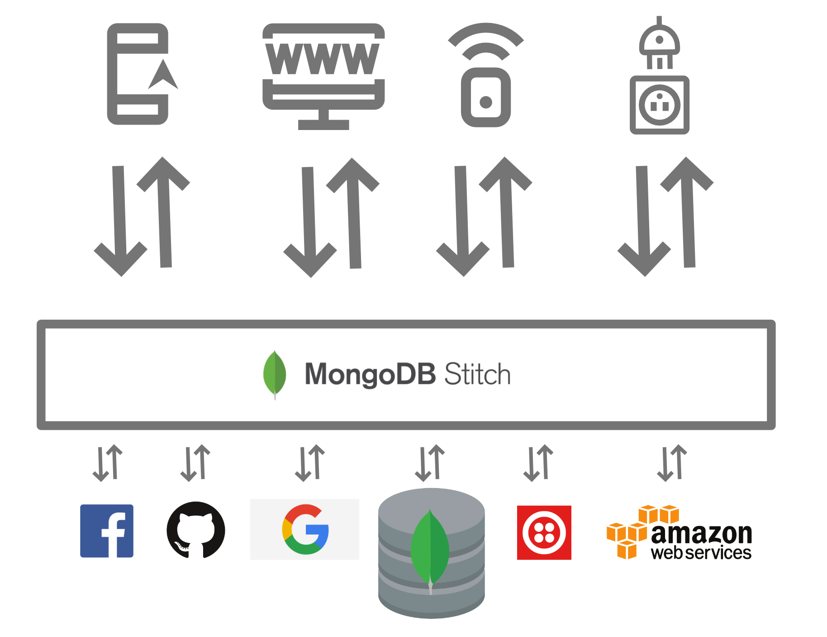
MongoDB Stitch Serverless Platform
Streamlines app development with simple, secure access to data and services from the client with thousands of lines less code to write and no infrastructure to manage.
Getting your apps to market faster while reducing operational costs.
Notes:
Stitch is MongoDB’s serverless platform, a service we host that lets developers build better apps faster, and at a lower cost.

Slide 52

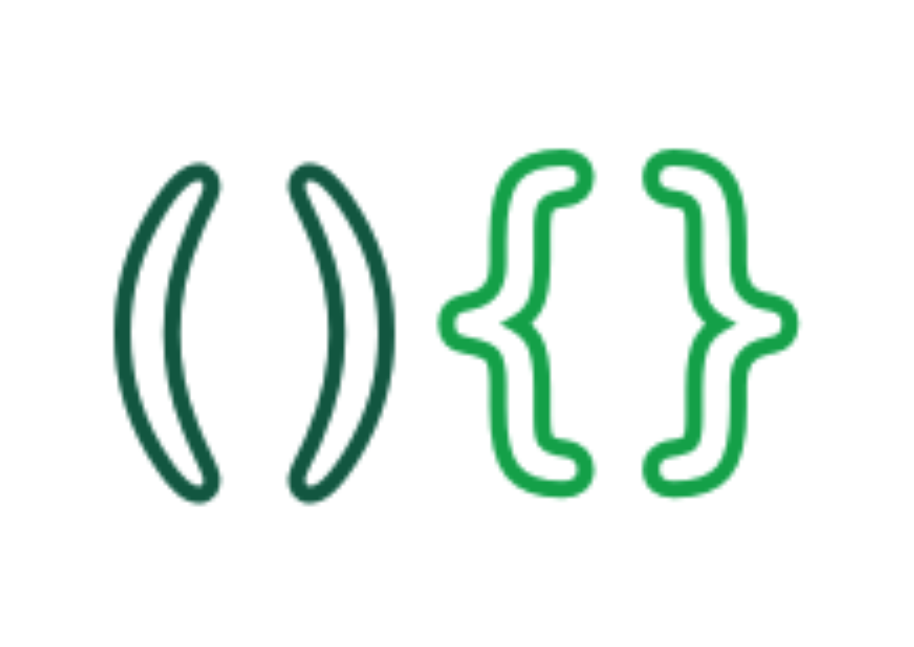


MongoDB Stitch Serverless Platform – Services
Stitch QueryAnywhere
Brings MongoDB's rich query language safely to the edge
iOS, Android, Web, IoT
Stitch Functions
Integrate microservices + server-side logic + cloud services
Build full apps, or Data as a Service through custom APIs
Stitch Triggers
Real-time notifications let your application functions react in response to database changes, as they happen
(coming soon)
Stitch Mobile Sync
Automatically synchronizes data between documents held locally in MongoDB Mobile and your backend database
(coming soon)
Streamlines app development with simple, secure access to data and services from the client with thousands of lines less code to write and no infrastructure to manage – getting your apps to market faster while reducing operational costs.
Notes:
Stitch is our serverless platform, we provide 4 services on top of this platform.
The first is Stitch QueryAnywhere. This brings MongoDB's rich query language safely to your frontend devices. It provides an intuitive SDK which gives the developer full access to your MongoDB database from mobile and IoT devices (rather than forcing you to run backend servers to proxy the requests to MongoDB). Authentication and sophisticated access rules let you control precisely what data your users and devices can access.
For example, you could allow a doctor to read medical records for just their patients; allow a nurse to check for allergies and record test results; allow an administrator to execute a real-time aggregations to find which doctors or services are keeping patients waiting longest.
The second service is Stitch Functions.
Stitch let you create secure APIs or integrate with microservices and server-side logic. The same SDK that accesses your database, also connects you with popular cloud services, enriching your apps with a single line of code. Your custom, hosted JavaScript functions bring everything together.
For example, you can call a single line of code from the client application to submit an expense claim to the database, and send a text notification to the approver.
Stitch Triggers (Coming Soon) provide real-time notifications to let your application functions react in response to database changes, as they happen.
Stitch Triggers are built on top of change streams – making changes much simpler for the application to work with.
For example, send an email to a customer when their account balance falls below a threshold.
Stitch Mobile Sync (coming soon) automatically synchronizes data between documents held locally in MongoDB Mobile and your backend database.
For example, push gate changes to a mobile airline app, as they happen. Copy offline meal preferences to the backend when back online.

Slide 53
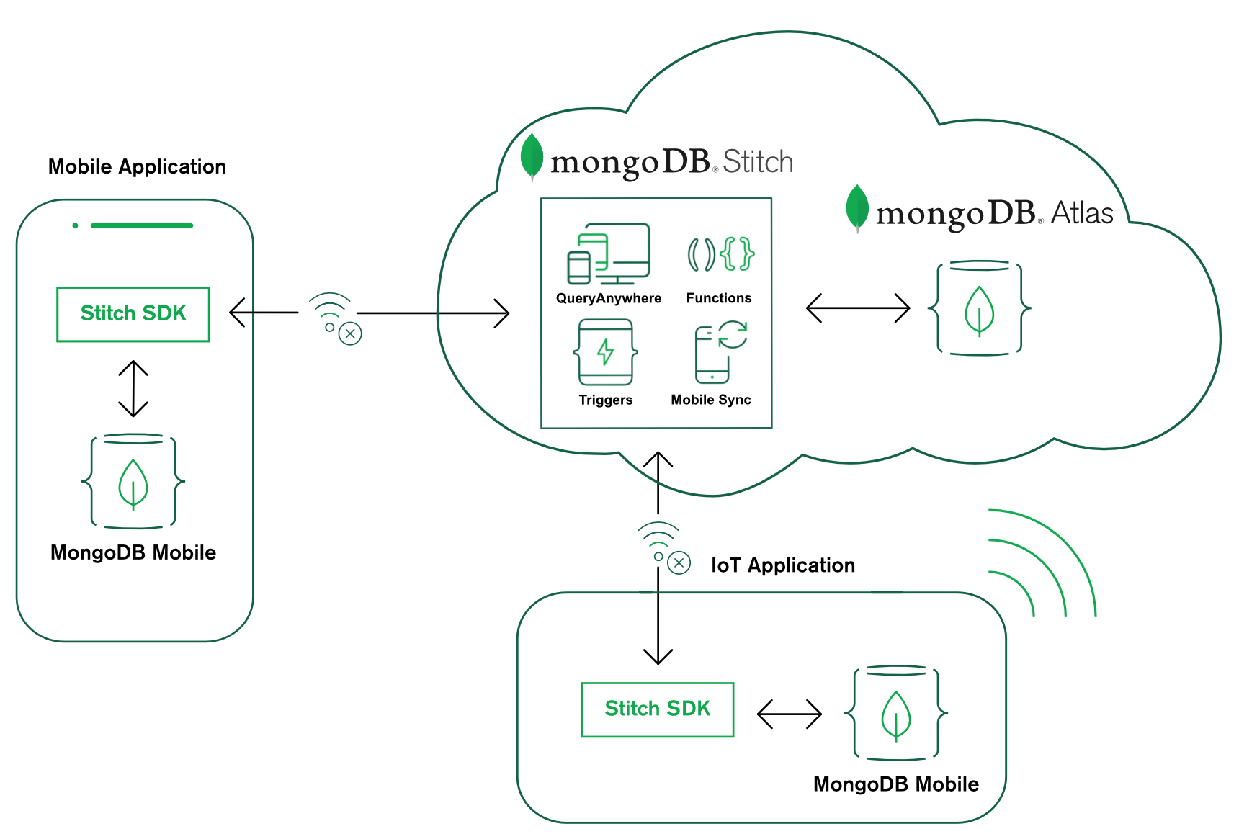
MongoDB Mobile
Brings the power of MongoDB to your device
Same database, same access patterns – from IoT to Mobile to Web.
Notes:
MongoDB Mobile is a major addition for MongoDB – allowing applications to store and access data in a MongoDB database running inside their IoT or mobile device. This isn’t some feature-constrained version of MongoDB either – you get the same query language, indexes, and aggregations as when you use MongoDB with WiredTiger.
MongoDB Mobile provides the power and flexibility of MongoDB in a compact form that is power and performance aware with a low disk and memory footprint. It supports 64 bit iOS and Android operating systems and is easily embedded into mobile and IoT devices for fast and reliable local storage of JSON documents. With secondary indexing, access to the full MongoDB query language and aggregations, users can query data any way they want. With local reads and writes, MongoDB Mobile lets you build the fastest, most reactive apps. Stitch Mobile Sync (coming soon) will automatically synchronize data changes between data held locally and your backend database, helping resolve any conflicts – even after the device has been offline.

Slide 54
Thank You!

